Slide 1

BrewBean's
COMP-214
Asignment-4

Slide 2


Team members & Their Contributions
Eunice Adinlewa
Tarik Obeidi
Fatimah Binti Yasin
Darosh Irani
Back-end Developer
Prepared Task- 4, 5 & 6
Front-end Developer
Prepared the GUI
Back-end Developer
Prepared Task- 1, 2 & 3
Back-end Developer
Prepared Report- 1, 2

Slide 3
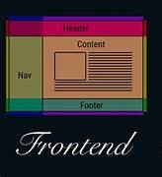

Tools
Type of Application: Web App
IDE: Visual Studio Code
Front-end development: HTML, CSS, JavaScript, Node.js, EJS
Back-end development: Oracle Sql developer

Slide 4




Challenges
Using SQL server first time for backend development
Choosing our application type​
Time zone differences​
Inconsistent Communication Channels

Slide 5


Experience
Overall, we had an amazing experience working as a group to develop this project. Our team consists of both front-end and back-end developer which made both sides work easier. All the work was contributed equally among the group members and everyone completed their assigned task before the deadline.

Slide 6


Similar Project
All of our group members have completed COMP229 (Web application development), where we developed an e-commerce web application for selling used products which was much similar to this project. The only difference it had is we used MongoDB for our back-end development instead of SQL developer.

Slide 7

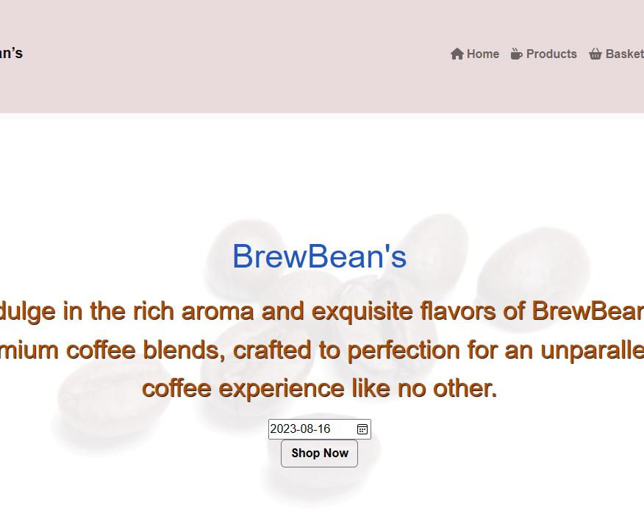
Demo

Slide 8

Thank You

